Slide 1
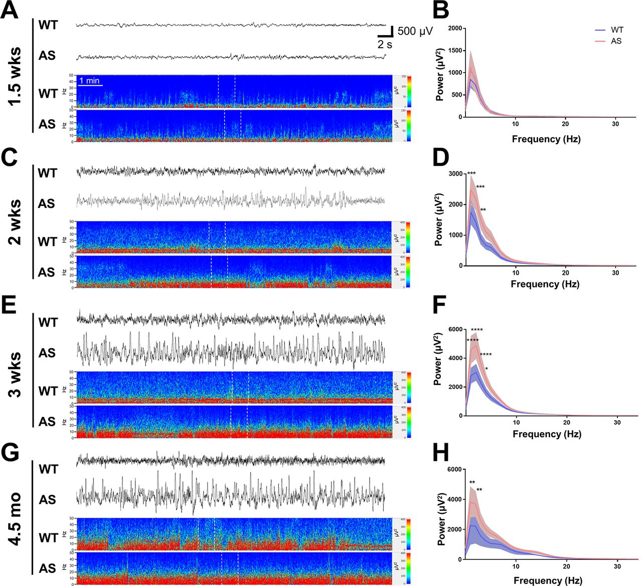
Digital Twin-Net for EEG Seizure Prediction
Presentation Topic: Exploring the methodology of Digital Twin-Net for EEG seizure prediction and proposing transformer-based enhancements.
Presenter Information: Presented by Research Intern Muhammad Umar.
Date of Presentation: Scheduled for 3rd August 2025, showcasing recent research and internship outcomes.

Slide 2
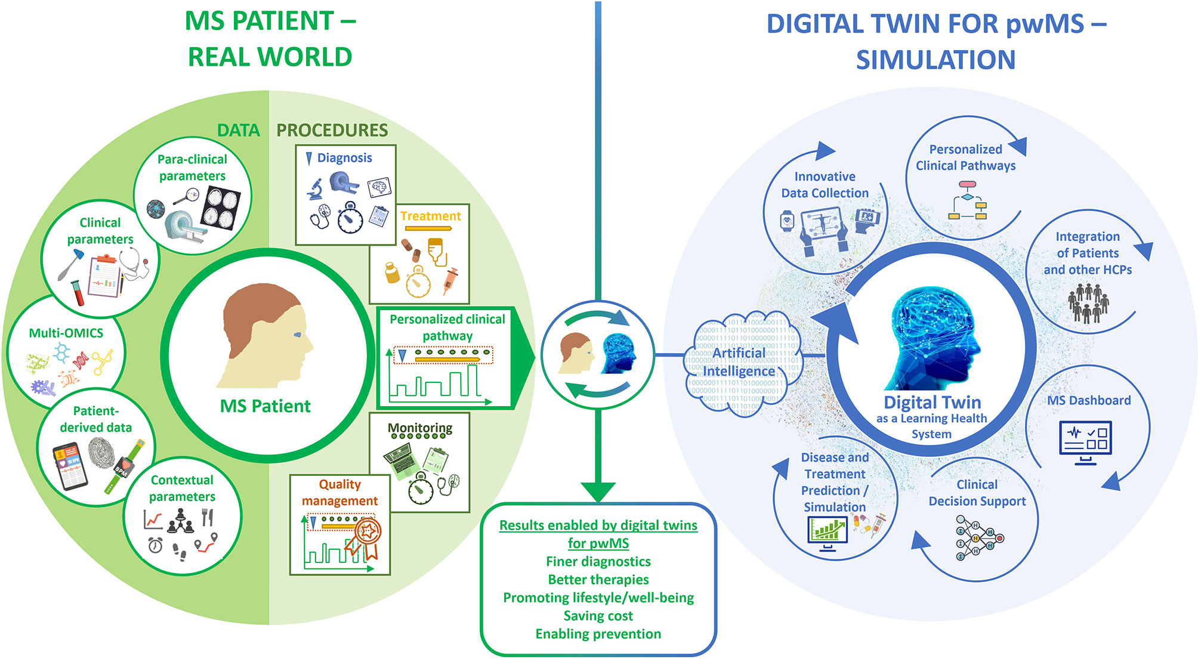
Motivation & Background
Epilepsy Burden: Epilepsy affects approximately 50 million people globally, with seizures occurring unpredictably and posing serious risks to patient safety.
EEG Prediction Goal: The aim of EEG-based seizure prediction is to provide early warnings, enabling timely interventions and improving patient outcomes.
Digital Twin Concept: A digital twin is a virtual model of a patient that allows for personalized seizure prediction by simulating individual brain dynamics.

Slide 3
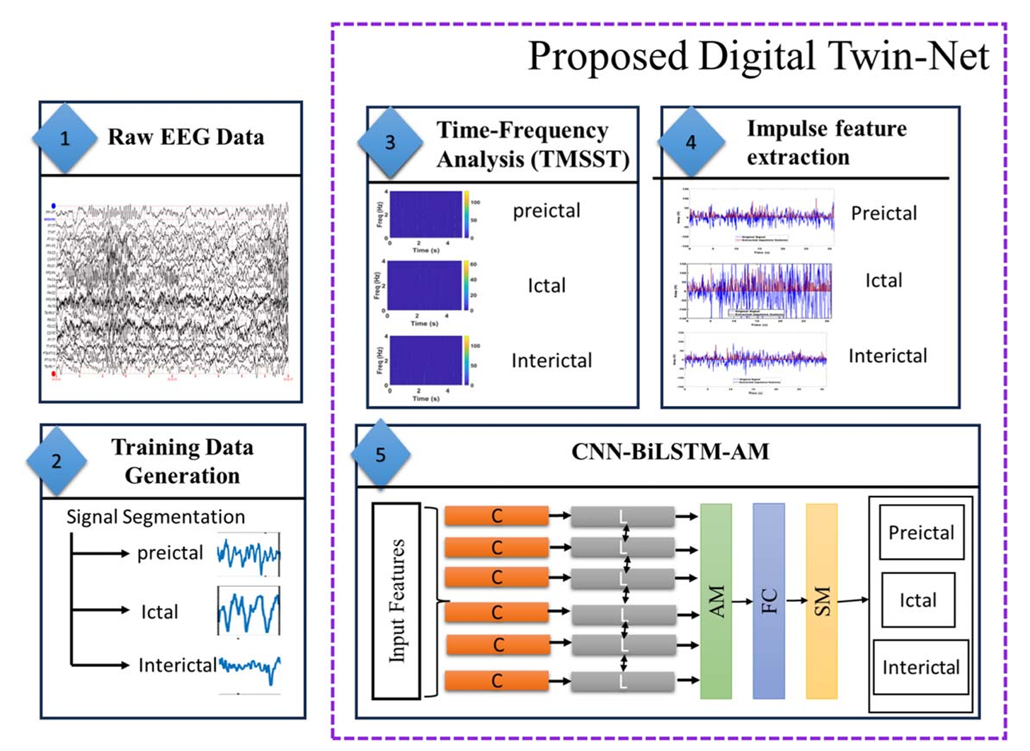
Baseline Digital Twin-Net (Ghosh & Dey, 2024)
Preprocessing with TMSST: Time–frequency transformation using TMSST produces sharp spectrograms that highlight seizure-related features.
Model Architecture: Combines CNN for spatial features, BiLSTM for temporal dynamics, and attention for focusing on critical time points.
Performance & Limitations: Achieves 99.70% accuracy on CHB-MIT dataset but requires patient-specific retraining and lacks global context due to sequential RNN processing.
Stepsoftheproposedr,SM:SoftMaxActivation].

Slide 4

Internship Objectives
Reproduce Baseline Results: Validate the original Digital Twin-Net performance on the CHB-MIT dataset to establish a strong foundation for enhancements.
Innovate Preprocessing & Architectures: Introduce wavelet denoising and design transformer-based models including ViT and hybrid CNN+Transformer for improved prediction.
Evaluate & Document Contributions: Use leave-one-patient-out cross-validation and reflect on novel insights gained during the internship.
.

Slide 5
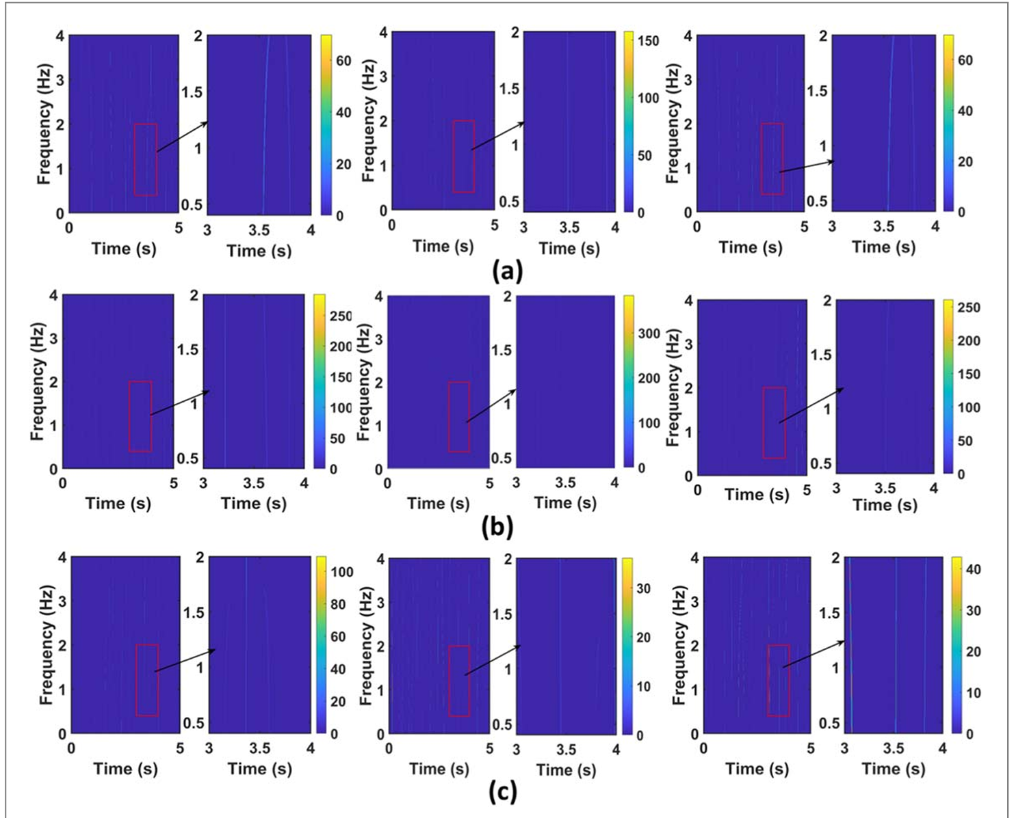
Enhanced EEG Preprocessing
Filtering Techniques: Applied a band-pass filter (0.5–40 Hz) and notch filter to remove baseline drift and powerline noise, ensuring cleaner EEG signals.
Wavelet Denoising: Used wavelet transforms to suppress non-neural artifacts such as ocular and EMG noise, enhancing signal quality.
TMSST Transformation: Time–frequency reassignment via TMSST produces concentrated spectrograms that highlight seizure-related impulses.
TMSST results for three EEG channels with zoomed portions marked inred.
(a)Channel1:Preictal,ictal,andinterictal phases,(b)Channel10: Preictal,ictal,and interictalphases,and (c)Channel23: Preictal, ictal, and interictal phases.

Slide 6
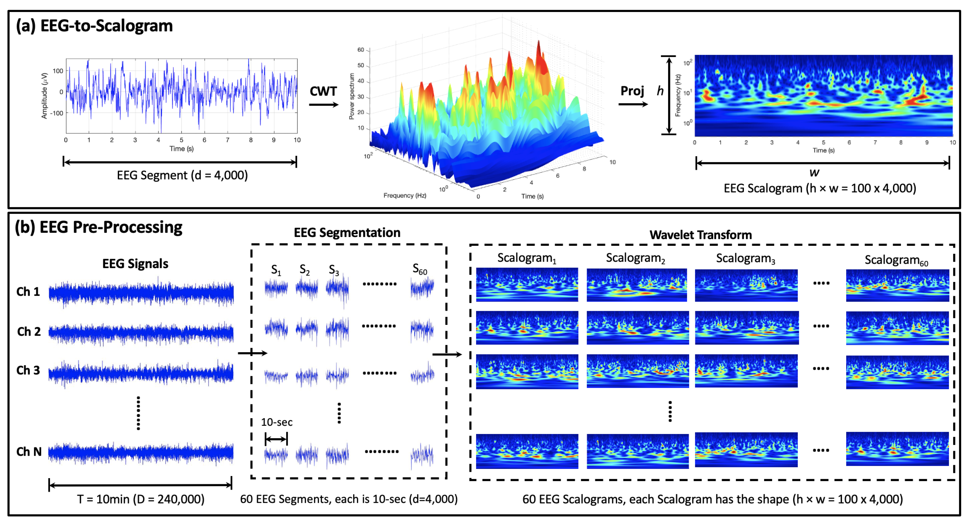
Multi-Channel Vision Transformer (ViT)
Input Representation: TMSST spectrograms are divided into 16×16 patches per EEG channel, enabling spatially localized feature learning.
Transformer Architecture: 23 parallel Transformer encoder branches process each channel independently, using multi-head self-attention to capture spatial and spectral relationships.
Design Rationale: Parallel processing and global context modeling improve scalability and seizure prediction accuracy.

Slide 7
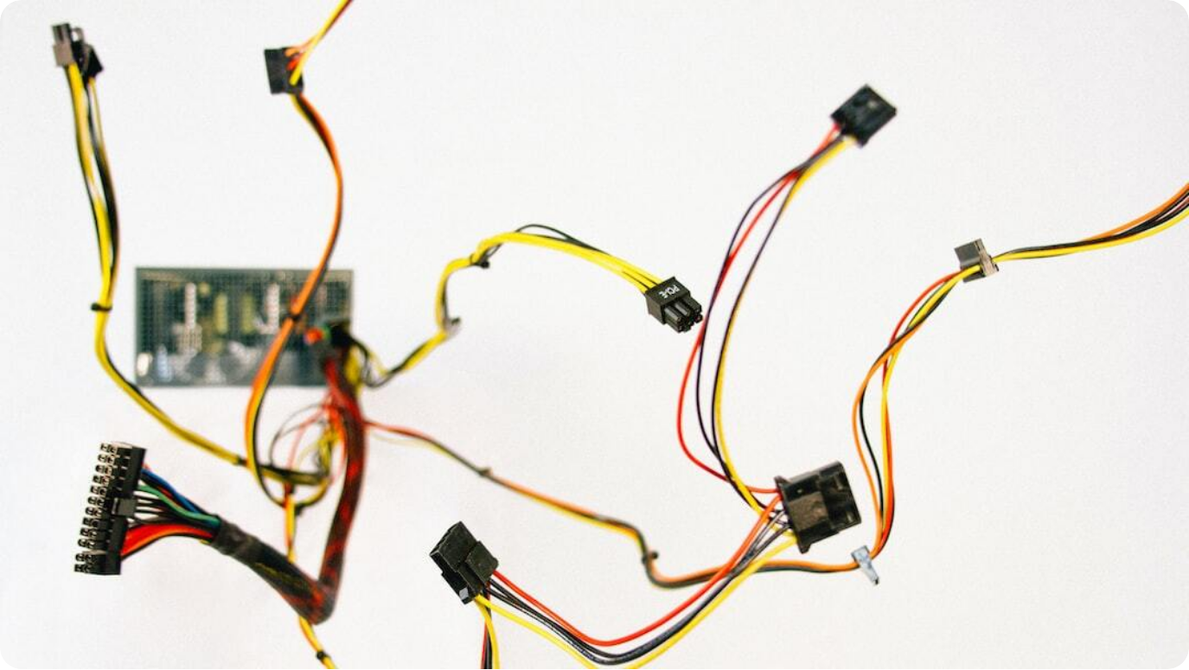
Hybrid CNN + Transformer Encoder
CNN Front-End: Extracts localized spatial features from each EEG frame, leveraging CNN’s inductive bias for structured data.
Transformer Sequence Modeling: Applies positional encodings and self-attention across time steps to capture long-range temporal dependencies.
Combined Benefits: Integrates CNN’s local feature extraction with Transformer’s global context modeling for robust seizure prediction.

Slide 8
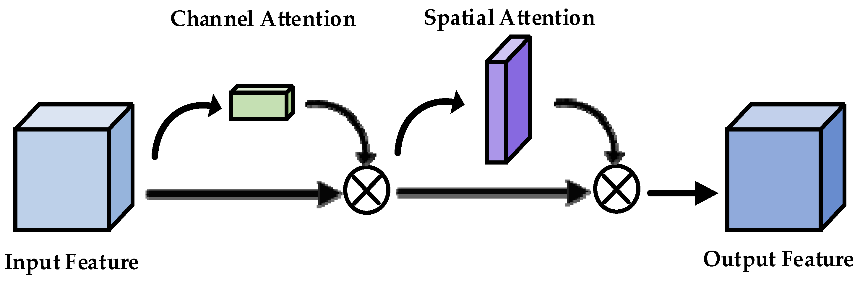
Dual-Attention Mechanism
Spatial Attention: Learns the relative importance of each EEG channel, allowing the model to focus on spatial regions most indicative of seizure activity.
Temporal Attention: Highlights critical time windows in the EEG signal, especially those preceding seizure onset, improving early detection.
Fusion Layer: Combines spatial and temporal attention scores to produce a refined feature map that enhances interpretability and sensitivity.

Slide 9
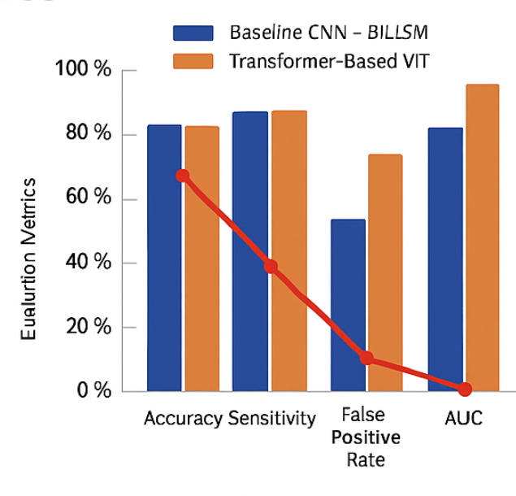
Quantitative Results
Performance Comparison: Baseline CNN–BiLSTM model achieved 99.70% accuracy, while the Transformer-based ViT model improved to 99.80% with lower false positive rate.
Evaluation Metrics: Metrics include Accuracy, Sensitivity, Specificity, False Positive Rate per hour, and AUC to assess model reliability and clinical relevance.
Key Gains: ViT model shows +0.10% accuracy improvement and reduced false alarms, indicating better generalization and early seizure detection.

Slide 10
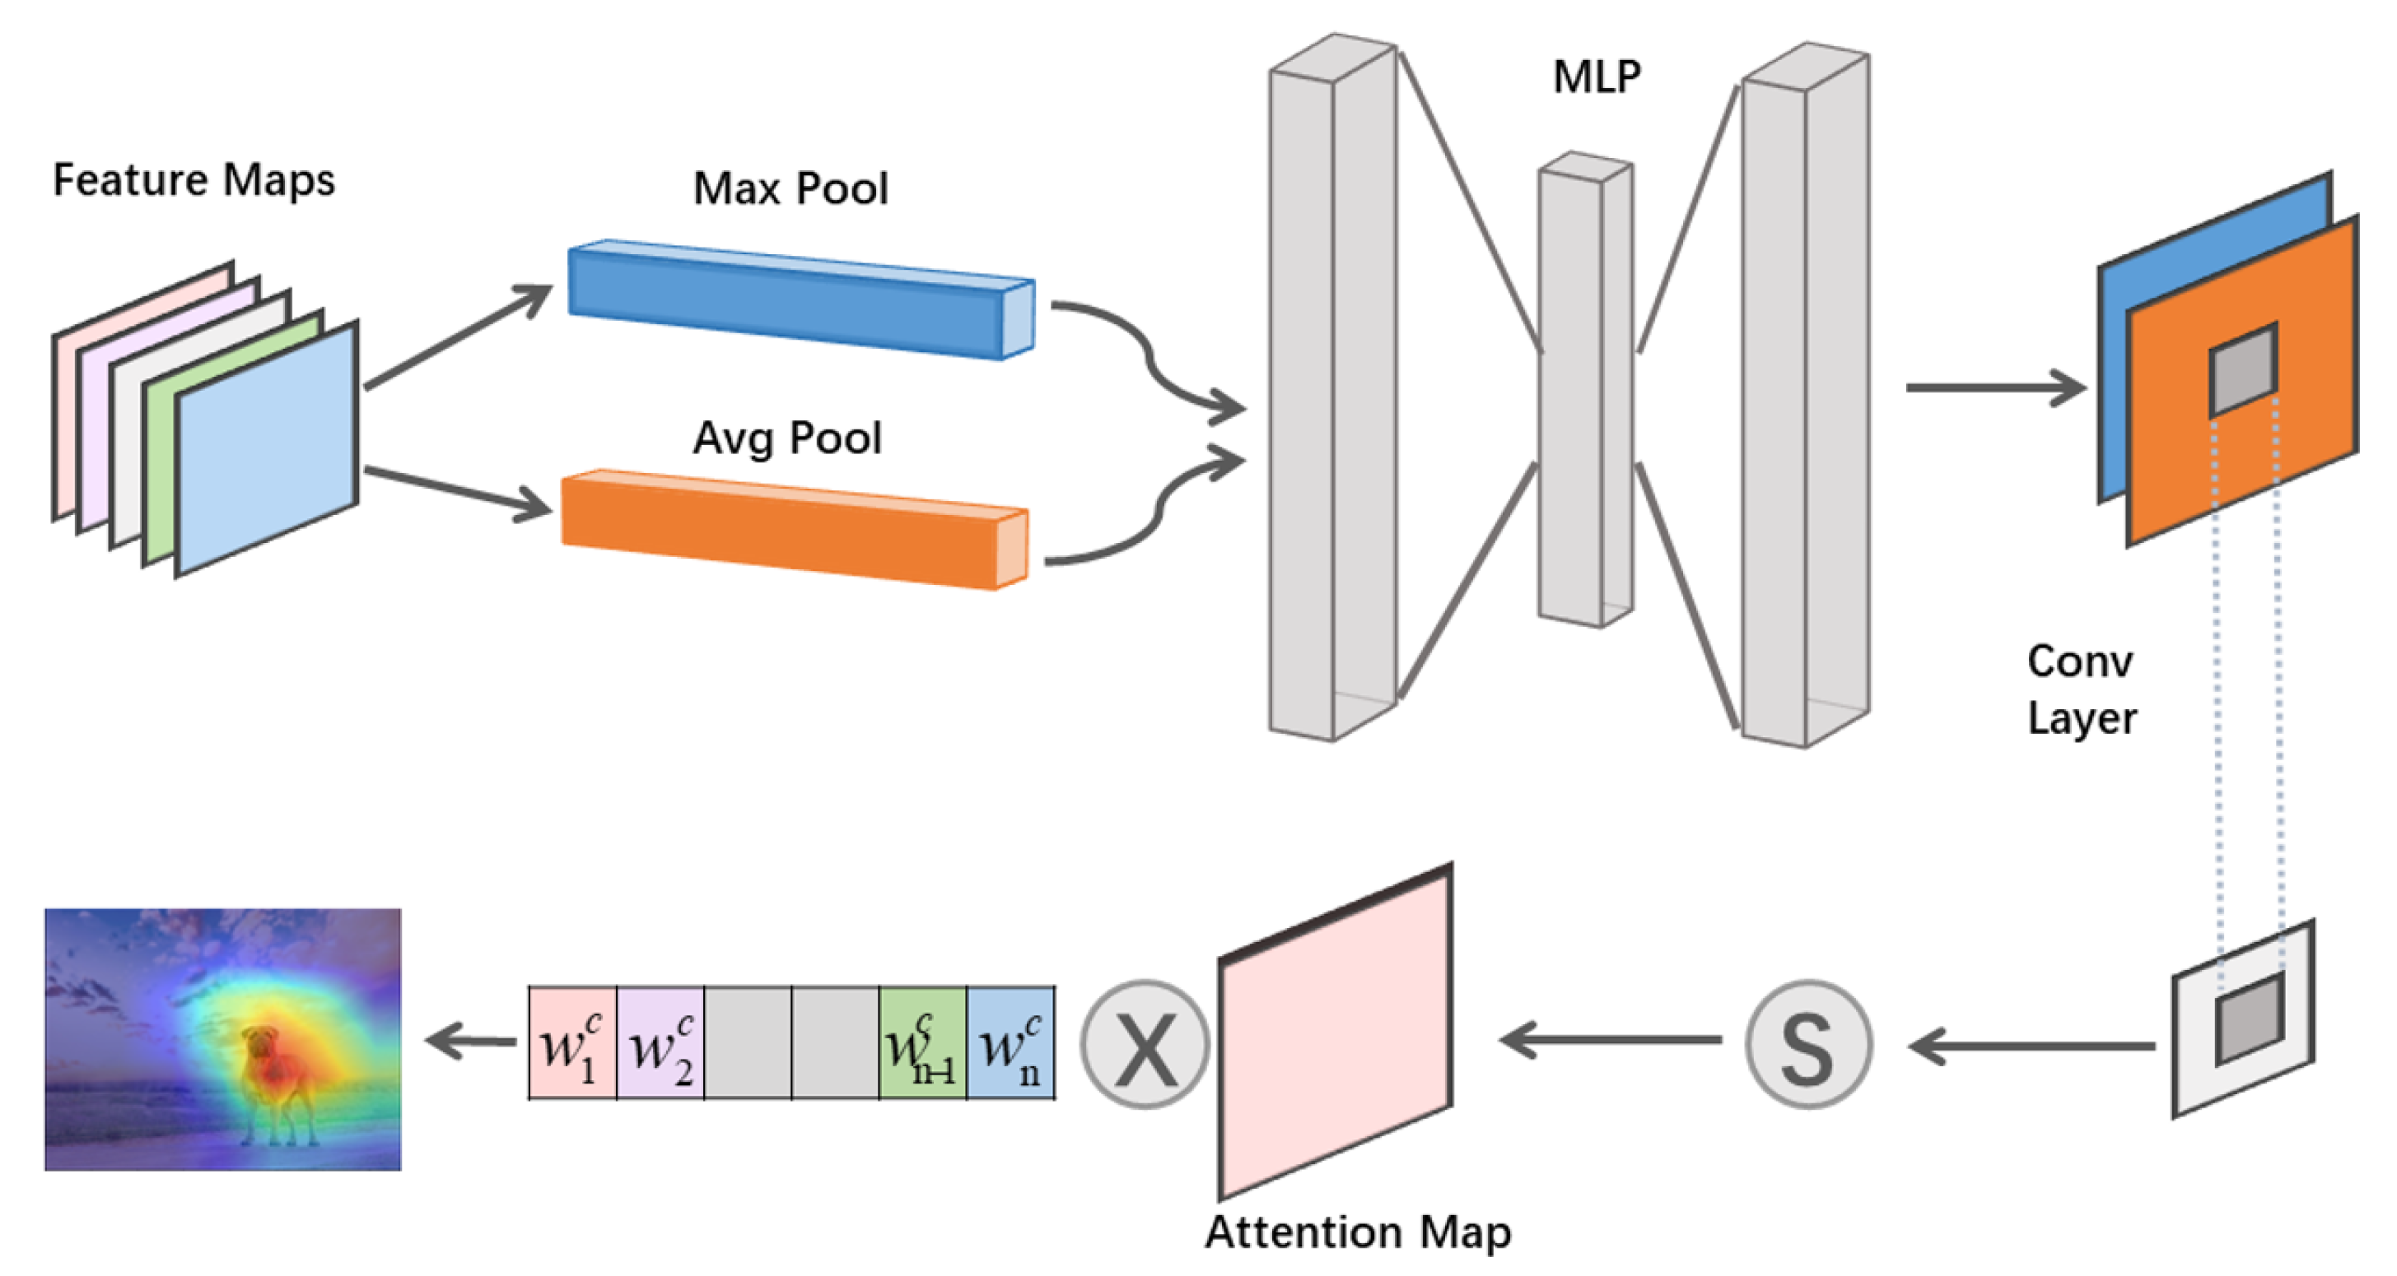
Attention Map Insights
Frequency Band Focus: Attention heatmaps reveal strong focus on 4–12 Hz bands, particularly alpha and theta rhythms, which are known to precede seizures.
Spatial Localization: High attention weights observed on temporal lobe channels (T7, T8), aligning with clinical seizure origination zones.
Preictal Window Detection: Model consistently highlights EEG segments 5–10 seconds before seizure onset, supporting early prediction capabilities.

Slide 11

Challenges & Solutions
EEG Noise & Artifacts: Addressed using wavelet denoising and strict filtering techniques to enhance signal clarity and reduce false detections.
Transformer Overfitting: Mitigated through dropout, label smoothing, and curriculum learning strategies to improve generalization.
GPU Memory Constraints: Overcome by applying mixed-precision training and optimizing patch sizes for efficient computation.

Slide 12

Personal & Technical Growth
Skills Gained: Developed expertise in TMSST implementation, PyTorch-based Transformer architectures, and mixed-precision training techniques.
Research Process: Followed a structured approach: hypothesis formulation, implementation, evaluation, and iterative refinement.
Soft Skills: Improved time management, independent problem-solving, and collaboration within a research team environment.

Slide 13
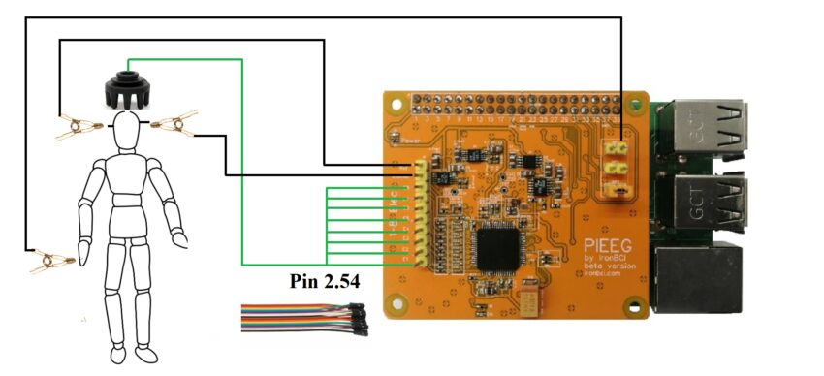
Future Directions
Cross-Patient Generalization: Explore meta-learning and domain adaptation techniques to improve model robustness across diverse patient profiles.
Multimodal Fusion: Integrate EEG with other biosignals like ECG or motion sensors using unified transformer architectures for richer context.
Real-Time & Explainability: Focus on model compression for deployment and enhance interpretability through attention visualization and clinician-friendly tools.

